Slide 1
Source-free domain adaptation 2020.10.13

Slide 2
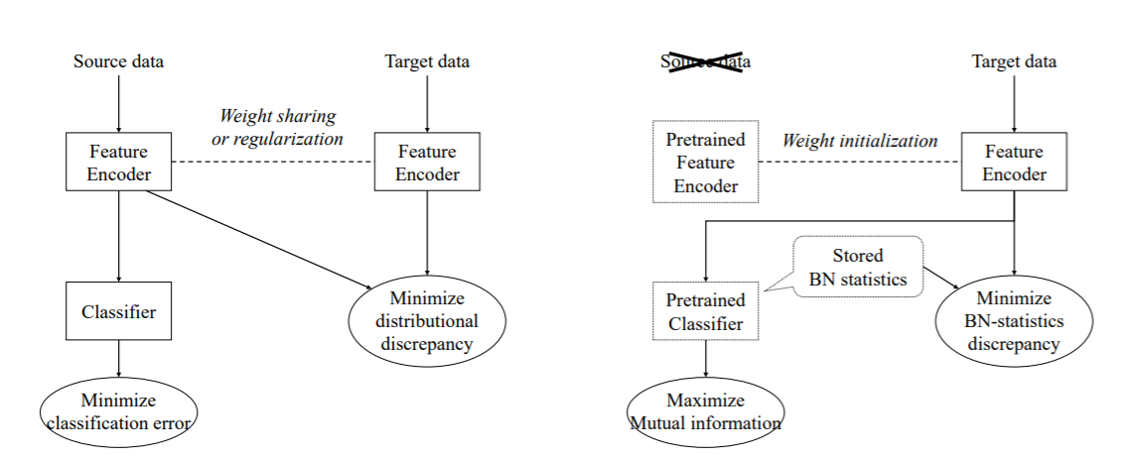
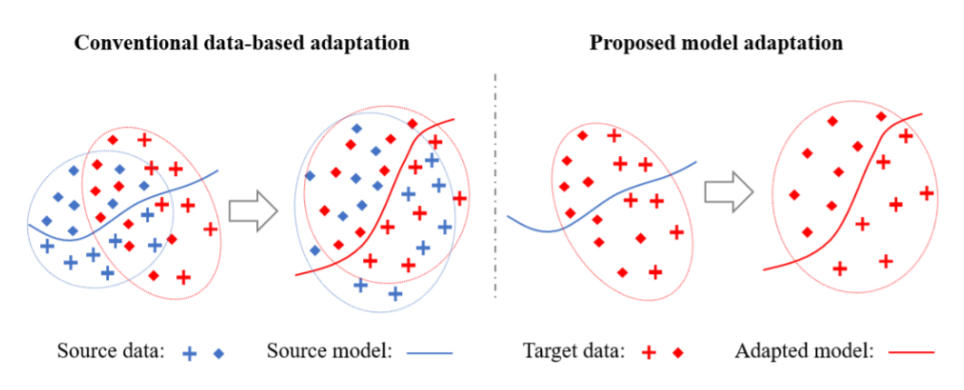
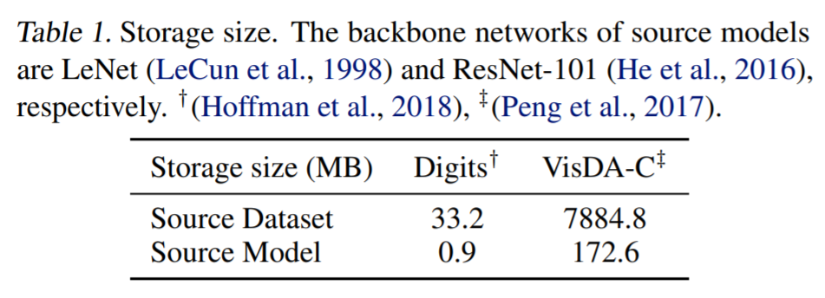
Why:
1.数据隐私和安全
2.存储空间大小
3.适用范围广
[1] Model Adaptation: Unsupervised Domain Adaptation without Source Data CVPR 2020
[2] Towards Inheritable Models for Open-Set Domain Adaptation CVPR 2020
[3] Universal Source-Free Domain Adaptation CVPR 2020
[4] Do We Really Need to Access the Source Data? Source Hypothesis Transfer for Unsupervised Domain Adaptation ICML 2020
[5] Source-free Domain Adaptation via Distributional Alignment by Matching Batch Normalization Statistics ICLR 2021 (under review)

Slide 3
几种学习范式对比 2020
 | 源域数据及类型 | 源域模型 | 目标域数据及类型 | 域间数据是否可以同时存在 | Source 和 target任务是否相同
DA | 有标签 |  | 无标签 | ✓
Pretrain-finetune |  | ✓ | 有标签
Federated Learning | 有标签 |  | 有标签 | ✗
Model reuse |  | ✓ | 有标签 | ✗ | ✗
Source free DA |  | ✓ | 无标签 | ✗ | ✓

Slide 4
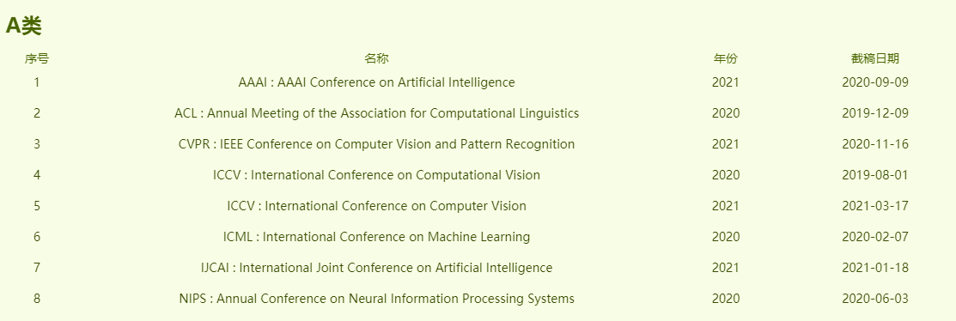

通知日期
2020-12-01
2021-05-05
2021-02-26
2020-06-01
2021-04-25
2020-09-25
ICLR: International Conference on Learning Representations
2021 (9th)
2021-10-02
2021-01-12
完成工作:3-4个月
审稿周期:3-4个月
开会前:2-3个月

Slide 5
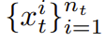
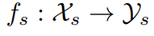
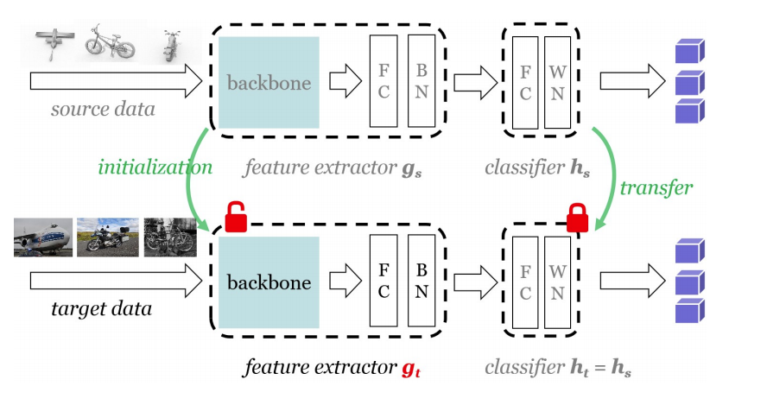
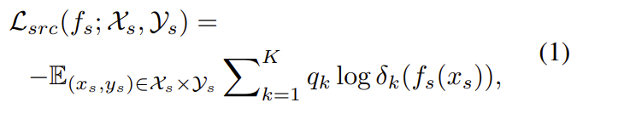
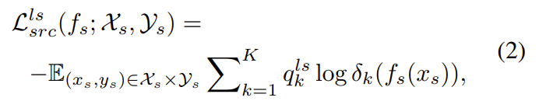
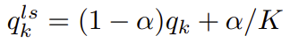
SHOT ICML 2020
Target unlabeled data
Source pre-trained model
Source Model Generation
[1] Do We Really Need to Access the Source Data? Source Hypothesis Transfer for Unsupervised Domain Adaptation ICML 2020

Slide 6
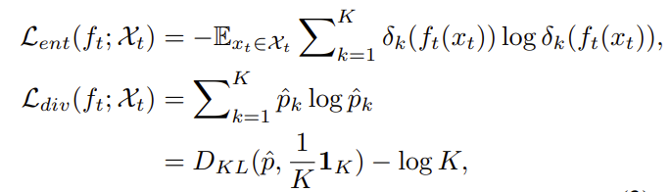
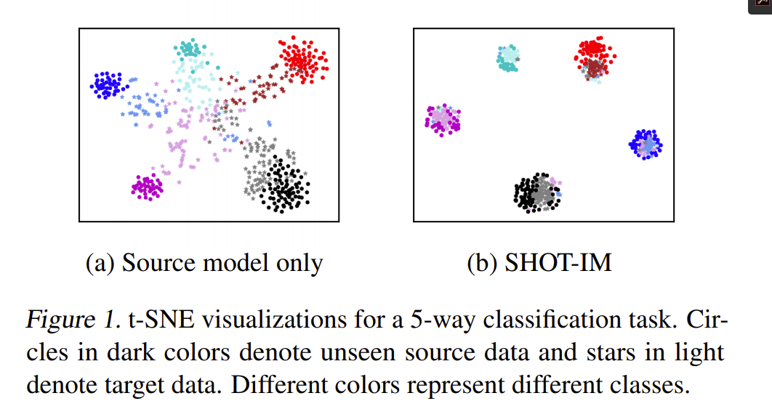
SHOT ICML 2020
Target unlabeled data
Source pre-trained model
2. Source Hypothesis Transfer with Information Maximization
(SHOT-IM)
[1] Do We Really Need to Access the Source Data? Source Hypothesis Transfer for Unsupervised Domain Adaptation ICML 2020

Slide 7
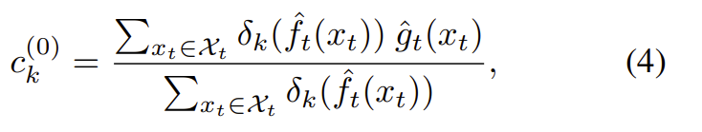
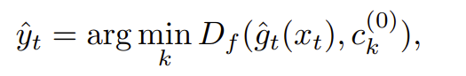
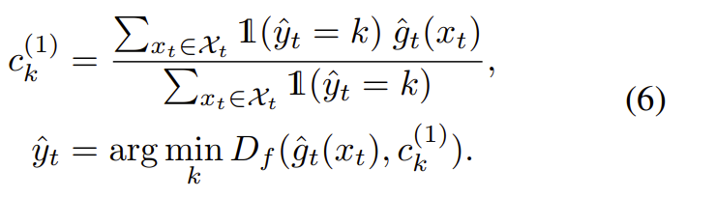
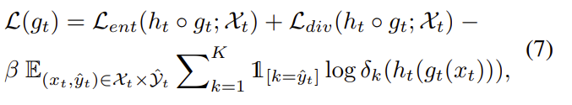
SHOT ICML 2020
Target unlabeled data
Source pre-trained model
3. Source Hypothesis Transfer Augmented with Self-supervised Pseudo-labeling
总目标:
[1] Do We Really Need to Access the Source Data? Source Hypothesis Transfer for Unsupervised Domain Adaptation ICML 2020

Slide 8
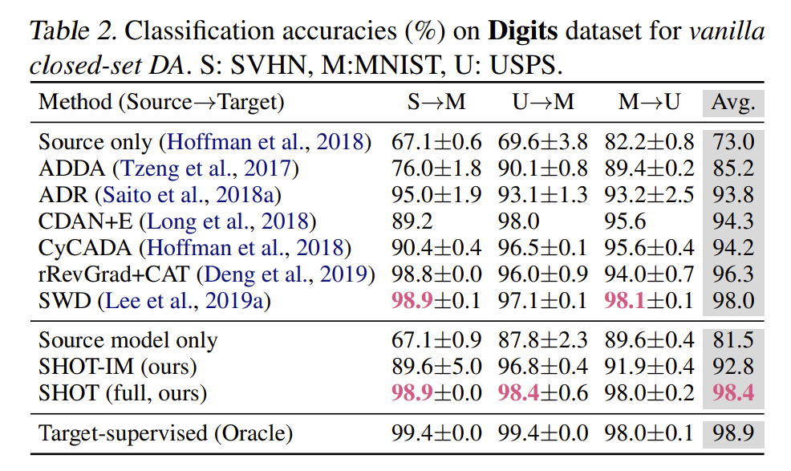
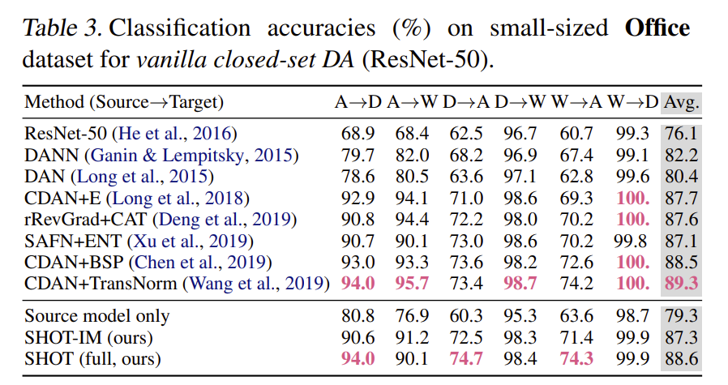
SHOT ICML 2020
[1] Do We Really Need to Access the Source Data? Source Hypothesis Transfer for Unsupervised Domain Adaptation ICML 2020

Slide 9
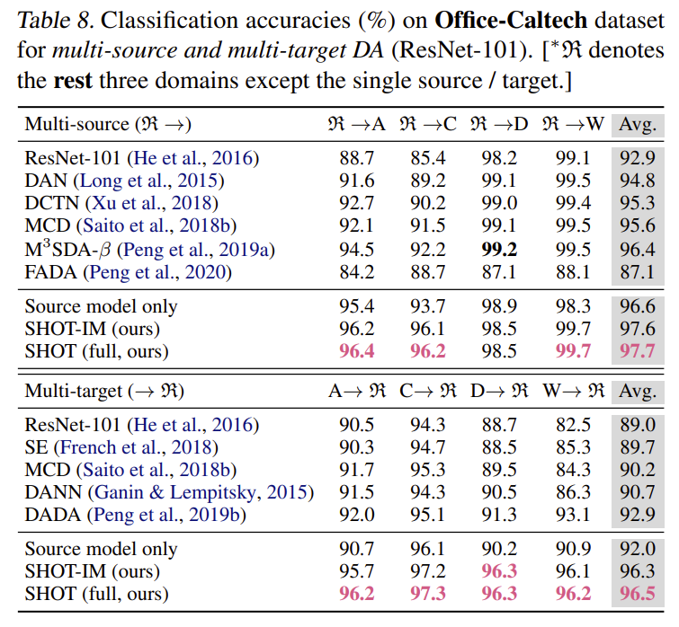
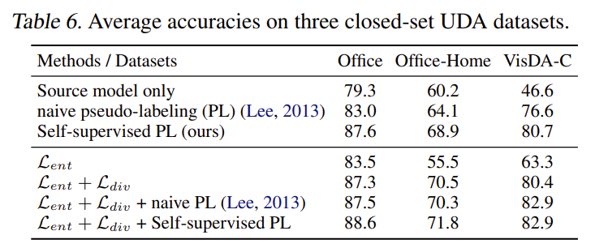
SHOT ICML 2020
存在的问题:
1.没有做域适应
2.没有有label的数据(source or target)存在
[1] Do We Really Need to Access the Source Data? Source Hypothesis Transfer for Unsupervised Domain Adaptation ICML 2020

Slide 10
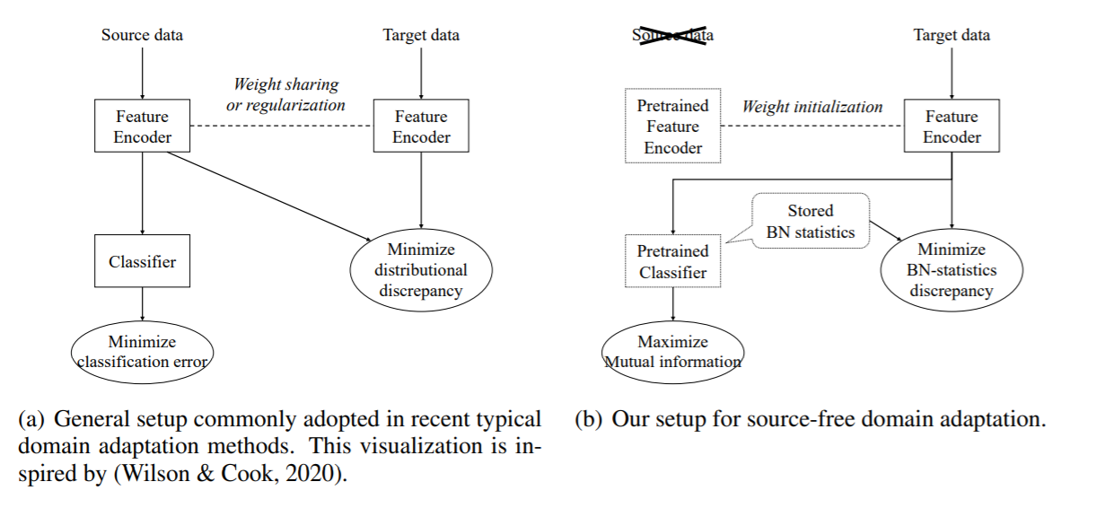
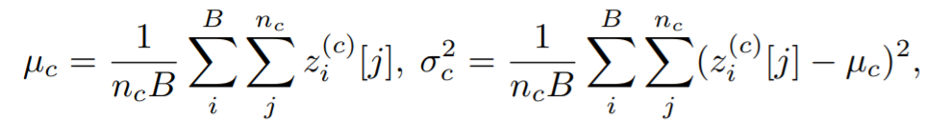
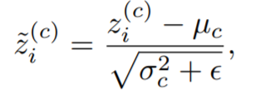
Source-free DA by BN matching ICLR 2021 under review
目标：做两个域特征的适配
Idea：训练好的模型中的BN层中包含训练数据的统计信息: 均值和方差。基于统计信息做域之间的匹配。
[5] Source-free Domain Adaptation via Distributional Alignment by Matching Batch Normalization Statistics ICLR 2021 (under review)

Slide 11
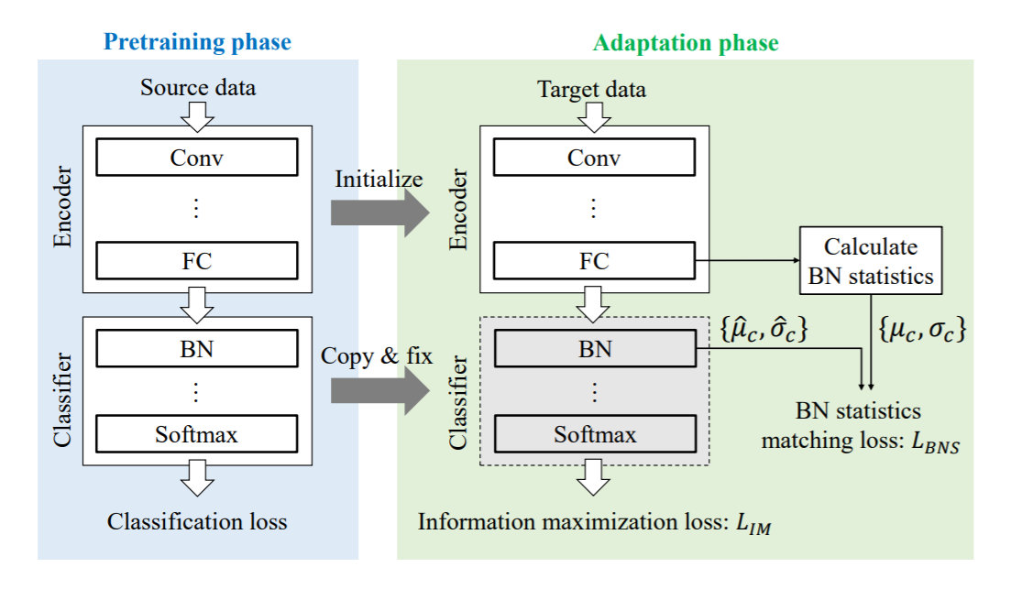
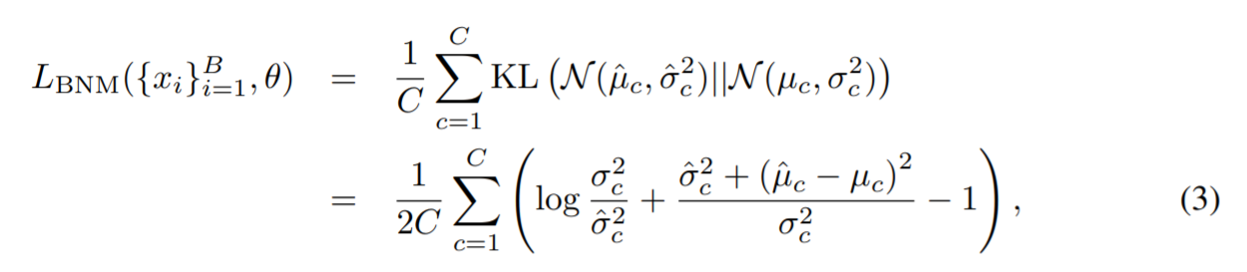
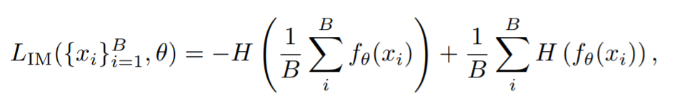
Source-free DA by BN matching ICLR 2021 under review
The distribution of target features extracted by the fine-tuned encoder is well aligned to that of source features extracted by the pretrained encoder.
● The features extracted by the fine-tuned encoder are sufficiently discriminative for the fixed classifier to accurately predict the class of input target data.
[5] Source-free Domain Adaptation via Distributional Alignment by Matching Batch Normalization Statistics ICLR 2021 (under review)

Slide 12
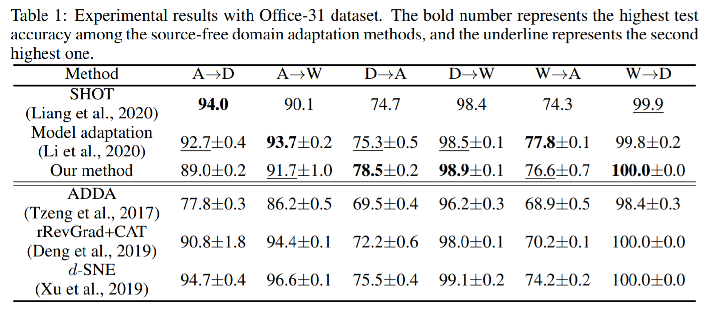
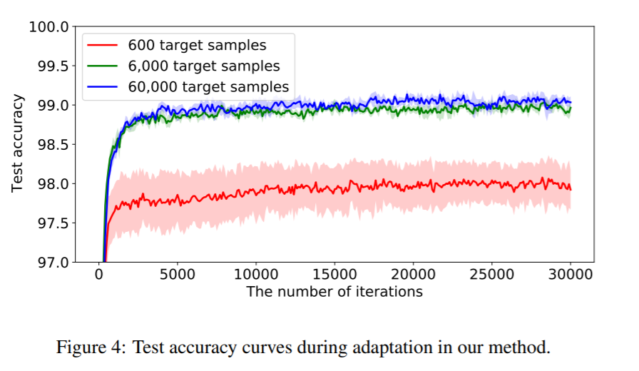
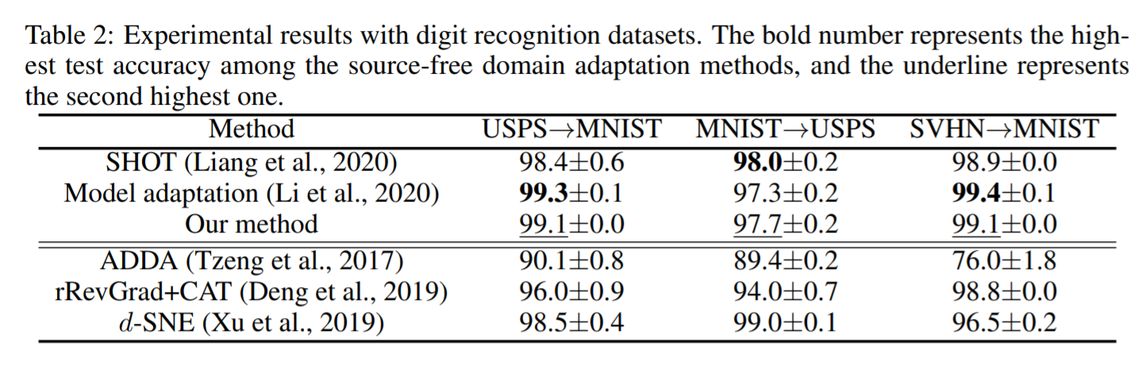
Source-free DA by BN matching ICLR 2021 under review
[5] Source-free Domain Adaptation via Distributional Alignment by Matching Batch Normalization Statistics ICLR 2021 (under review)

Slide 13
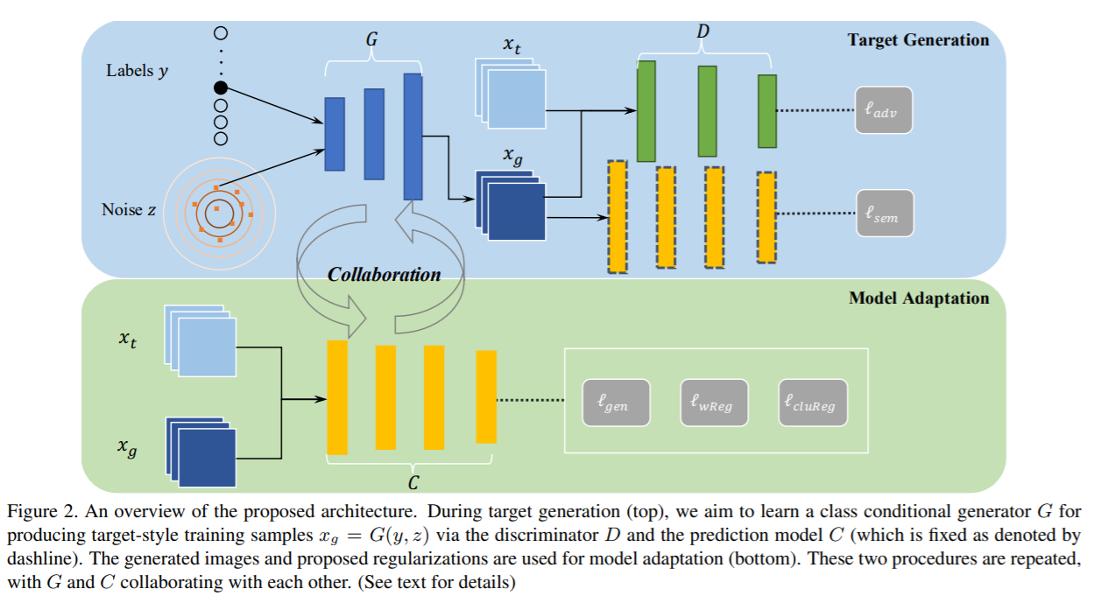
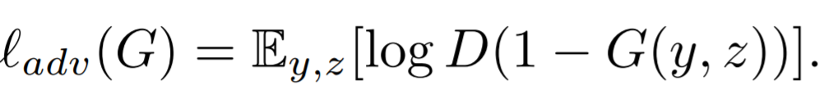
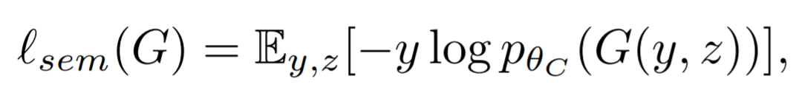
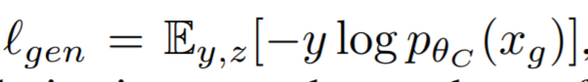
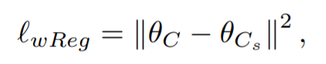
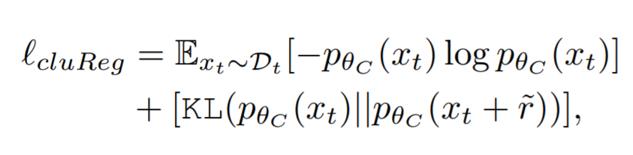
3C-GAN CVPR 2020
判别器
Motivation: 生成目标域风格的样本进行学习
生成器
分类器
[1] Model Adaptation: Unsupervised Domain Adaptation without Source Data CVPR 2020

Slide 14
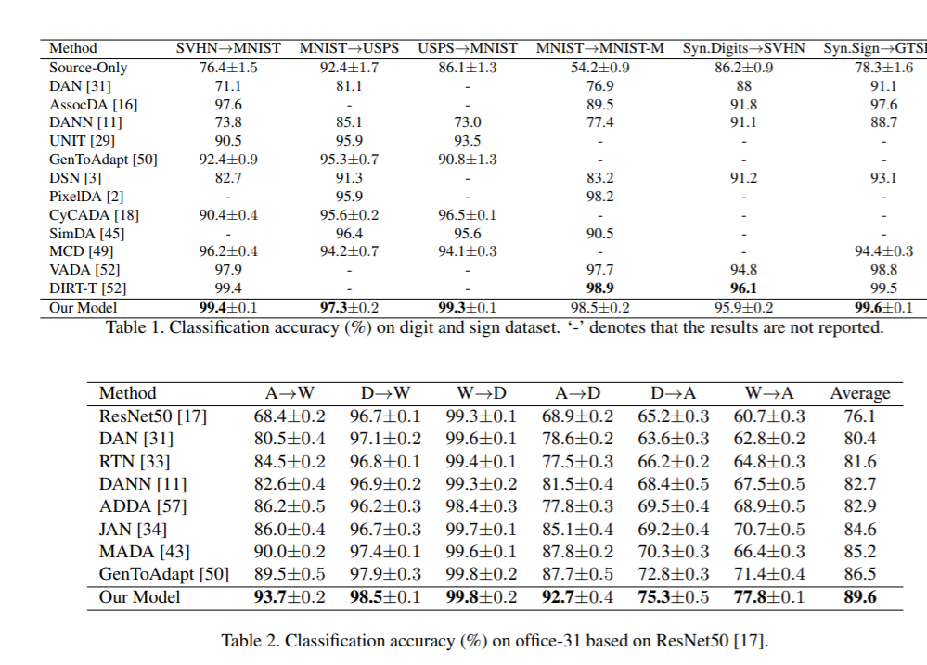
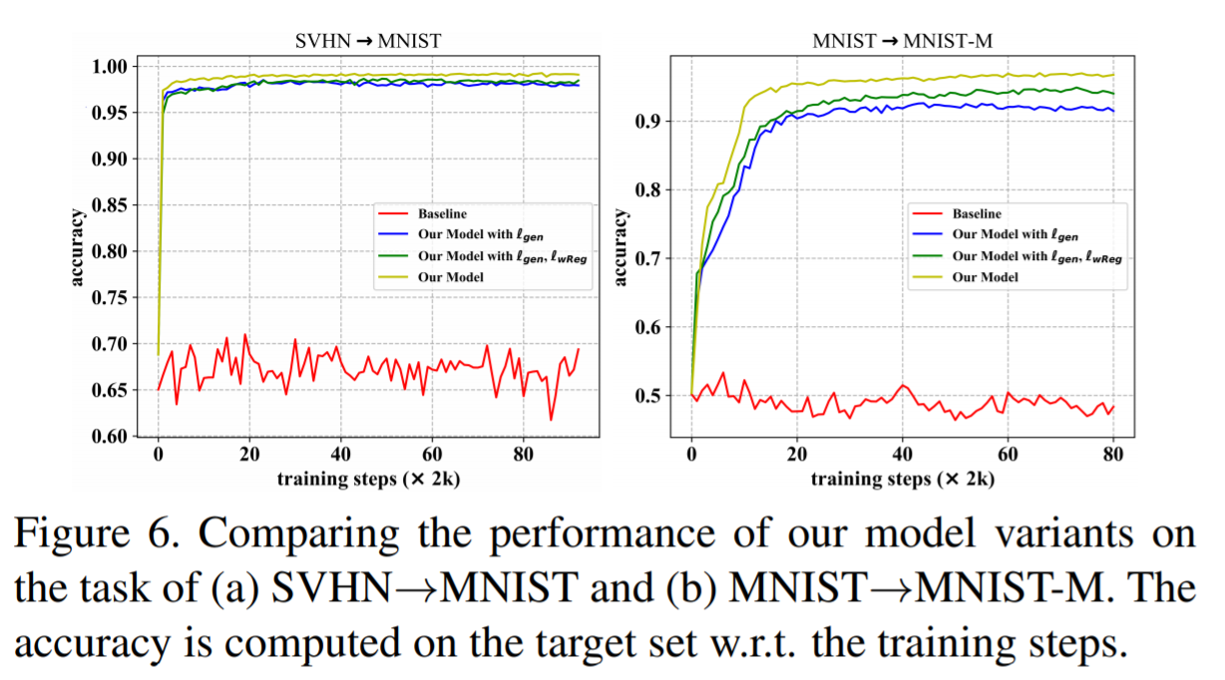
3C-GAN CVPR 2020
[1] Model Adaptation: Unsupervised Domain Adaptation without Source Data CVPR 2020

Slide 15
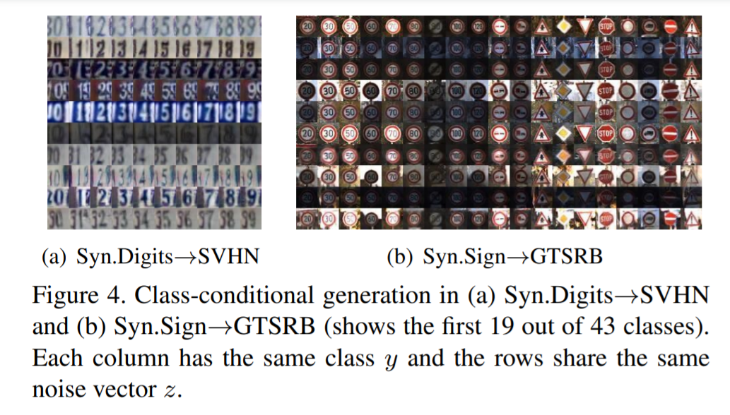
3C-GAN CVPR 2020
[1] Model Adaptation: Unsupervised Domain Adaptation without Source Data CVPR 2020

Slide 16
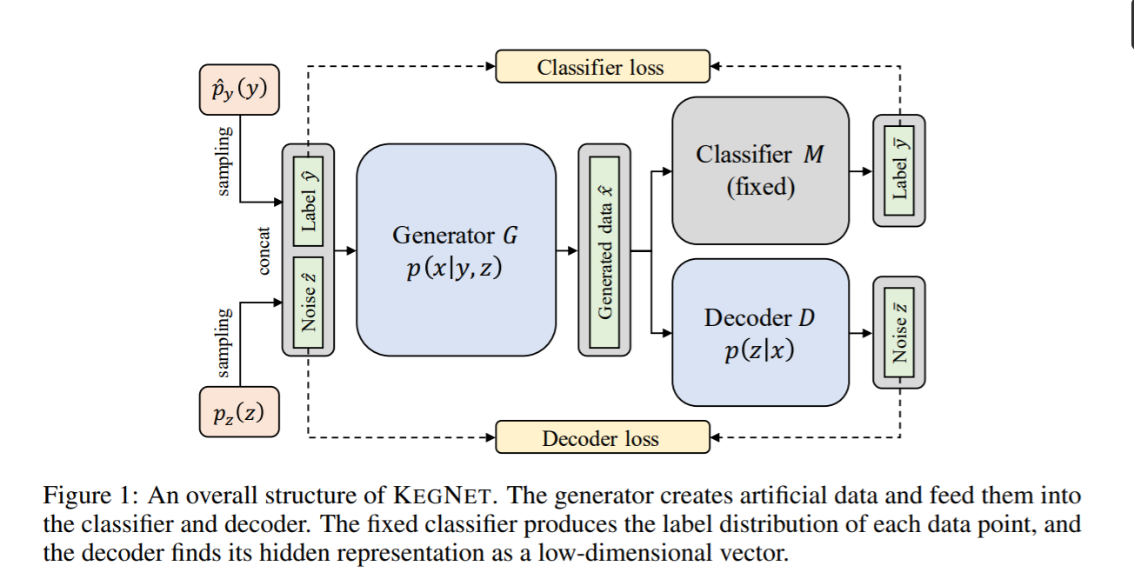
[6] Knowledge Extraction with No Observable Data NIPS 2019

Slide 17
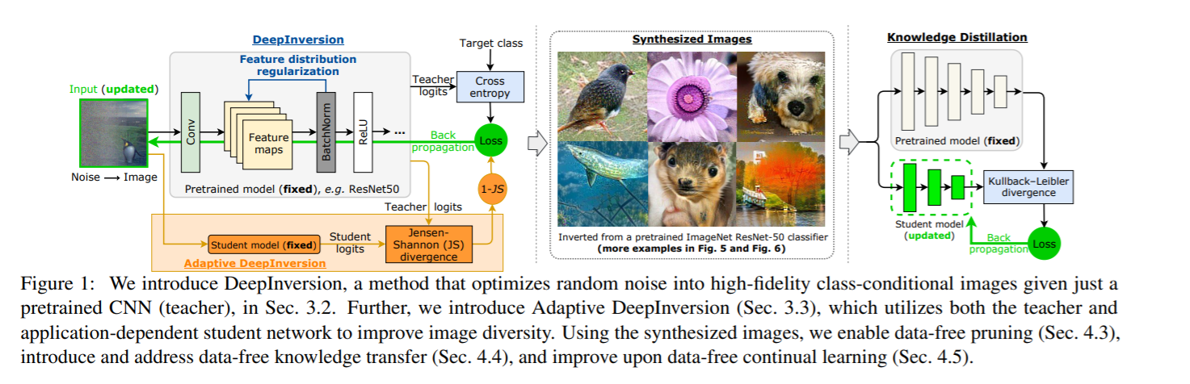
[6] Dreaming to Distill: Data-free Knowledge Transfer via DeepInversion CVPR 2020

Slide 18
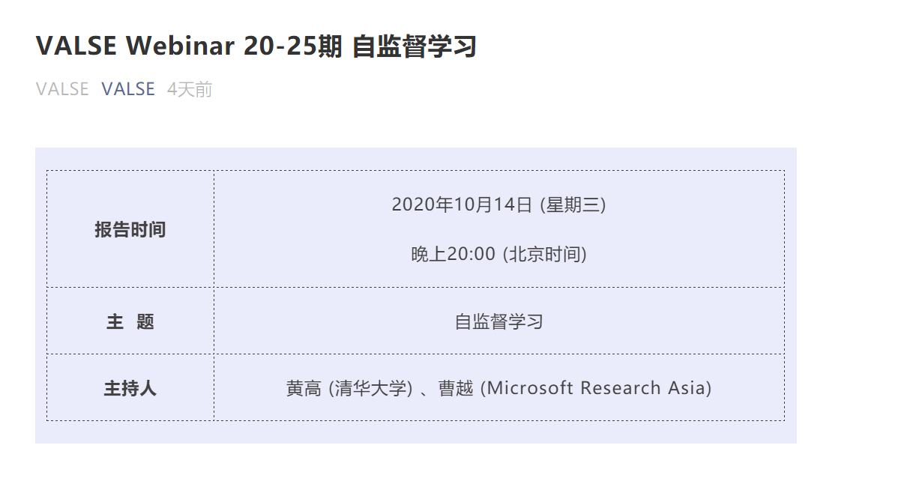
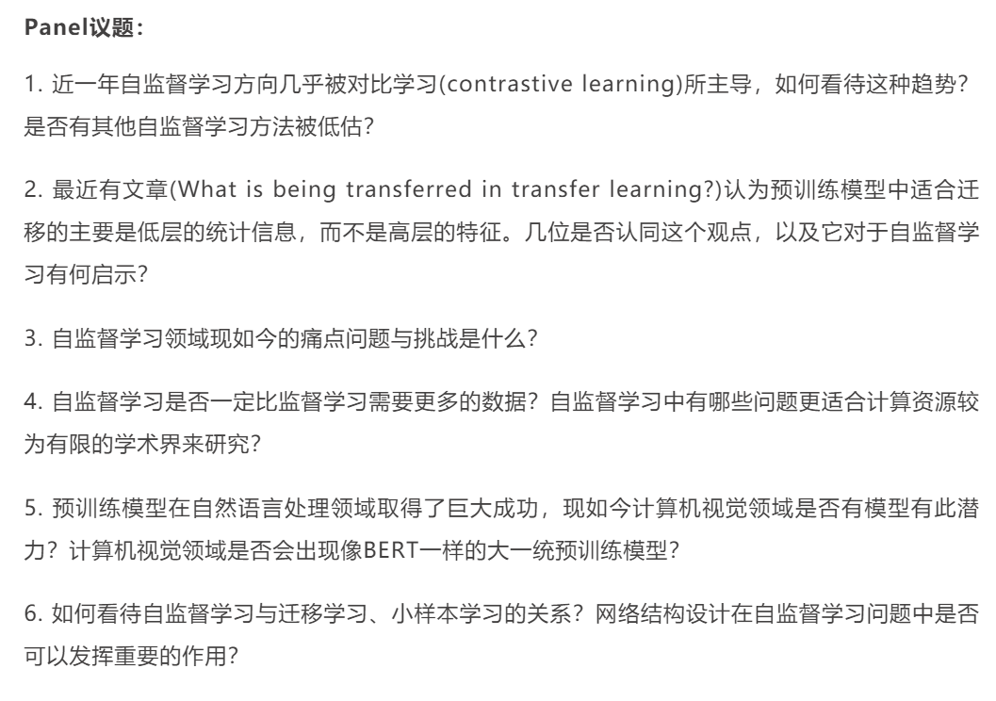
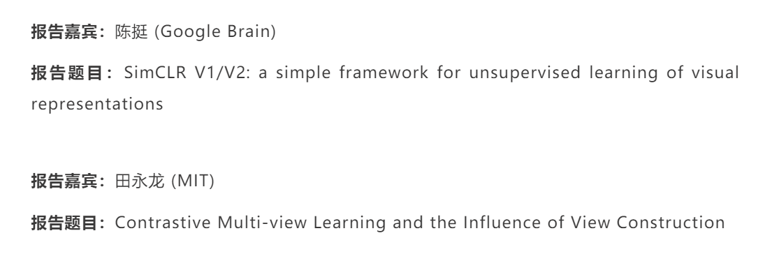

Slide 19
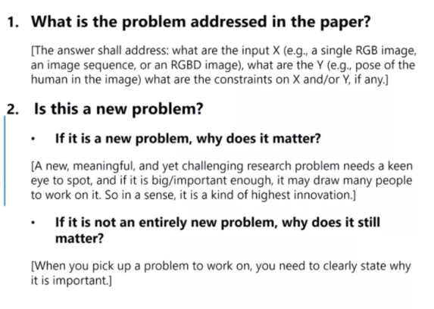
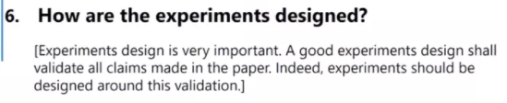
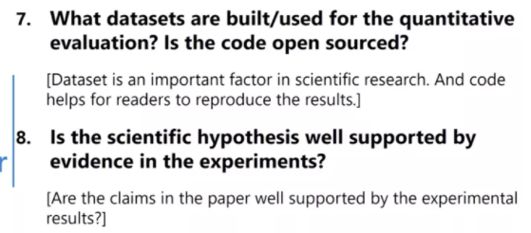
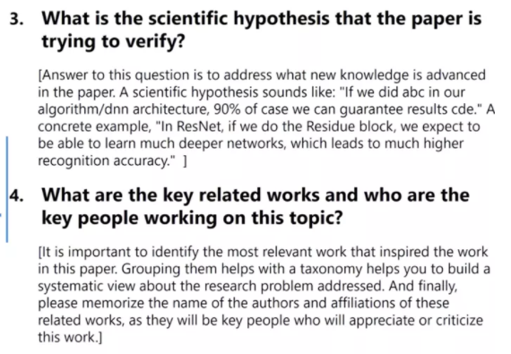
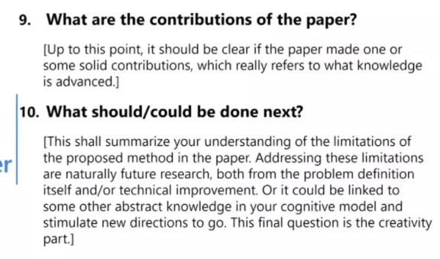
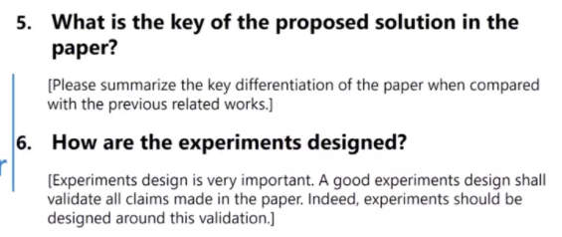

Slide 20
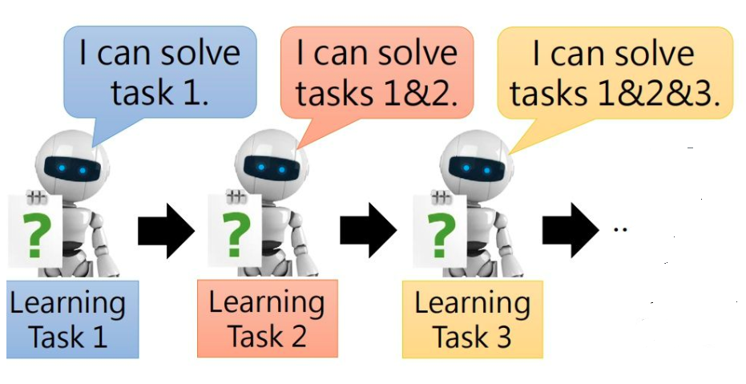
增量学习
1.forward:过去的任务对当前任务的帮助(有label)
2.backward:避免对过去的任务造成遗忘

